Slide 1

GenStorm
Fortunatus Aaabangbio. Wulnye: fortunatuswulnye@outlook.com
Dennis Agyemanh Nana Gookyi :dennisgookyi@gmail.com
Roger Kwao Ahiadormey :rogerkwao@gmail.com
May 30, 2024

Slide 2

Presentation Outline
Problem Statement
Objectives and Dataset
Methodology
Results
Future Direction
2

Slide 3
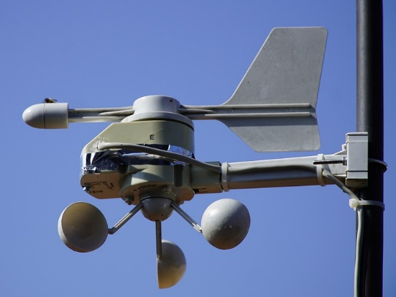
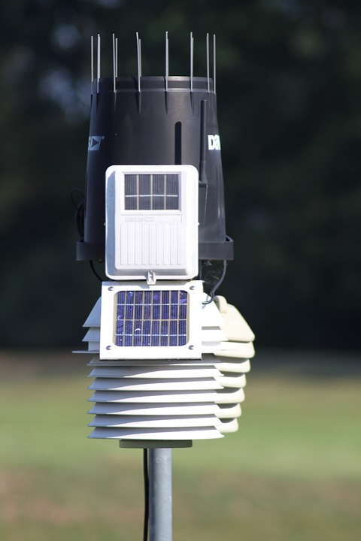
Anemometer
PROBLEM STATEMENT
Currently, weather elements such as wind and rain are monitored using mechanical instruments like tipping buckets and cup anemometers
Tipping bucket
This solution is simple and easy to implement but contains moving parts that are prone to failure

Slide 4
PROBLEM STATEMENT
PROBLEM STATEMENT
Inflexible rotation and stuck
Foreign stuff like leaves in the tipping bucket can block water block at that time
Damaged filters, funnels, cracks or deformations on the tipping bucket will seriously affect the accuracy of the measurement
Induction of the read switch is not sensitive

Slide 5
OBJECTIVES
This work is aimed at prototyping a low-cost and energy-efficient weather station capable of measuring environmental conditions including
Rainfall Intensity
Rainfall Amount
The weather station has no mechanical moving parts

Slide 6
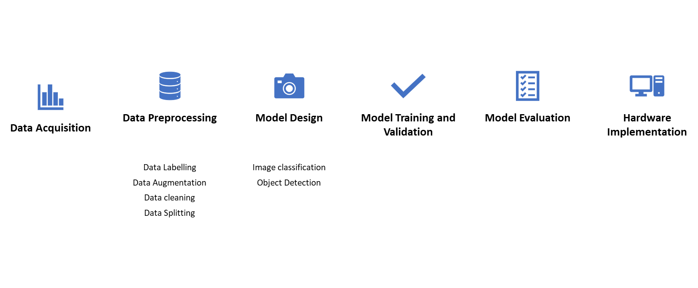
METHODOLOGY
This approach involves the application of deep learning algorithms to build a small-size classification model that can be deployed on an Arduino Nano 33 BLE Sense
This platform was selected due to its low cost, energy efficiency, and cost-effectiveness
Fig. 3 Proposed Approach flow.

Slide 7
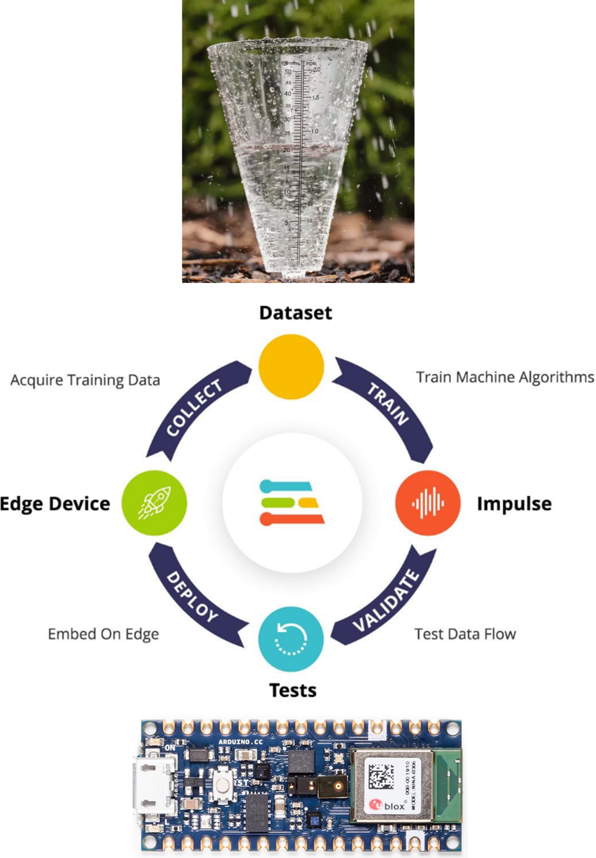
METHODOLOGY
Edge Impulse is a platform for developing and deploying embedded ML models on edge devices.
The platform provides various functions, including data acquisition, model training, model testing, and model deployment
Fig. 3 Edge Impulse

Slide 8
Datat
LOCATION | KOGI STATE, NIGERIA
MATERIAL FOR DATA COLLECTION | Galvanized ZINC Sheet
DURATION | 7,800 secs
DEVICE | TECHNO SPARK 7P MOBILE PHONE
FORMAT | .aac Format
BITRATE SAMPLING RATE | 22050 Hz
MONTH OF THE YEAR | SEPTEMBER, 2022
NUMBER OF DAYS | 12 days
RANGE OF RAINFALL INTENSITIES | 0.1 - 6.6mm/ 5mins
NUMBER OF SAMPLES COLLECTED | 25 (5 min per Sample)
The dataset used in this work was collected by AI4Africa [1]
This dataset provides essential audio recordings for training models to classify rainfall intensity based on acoustic signals
[1] https://github.com/ITU-AI-ML-in-5G-Challenge/tinyML_smart_weather_station_AI4Africa

Slide 9
Dataset Classification
The data is classified into five categories based on rainfall intensity
The dataset was split into training and testing sets in a ratio of 76/24
Category of Rainfall (Classes) | Rainfall Intensity (mm/5min)
VERY_HEAVY_RAIN | Greater than 3.5
HEAVY_RAIN | Between 1.5 - 3.5 exclusive
MODERATE_RAIN | Between 0.5 - 1.5 exclusive
LOW_RAIN | Between 0.08 - 0.5 exclusive
NO_RAIN | Below 0.08 - 0

Slide 10
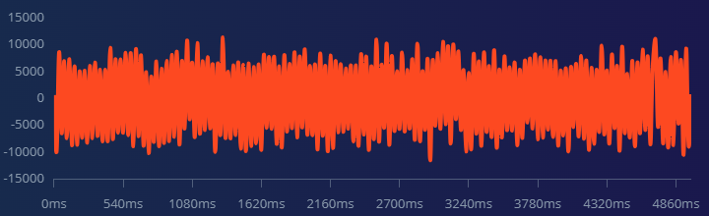
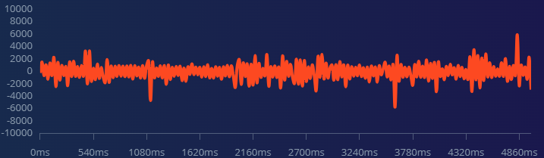
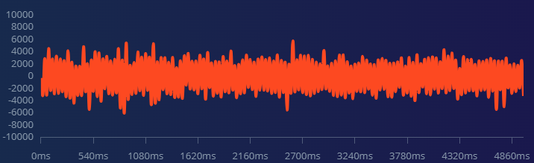
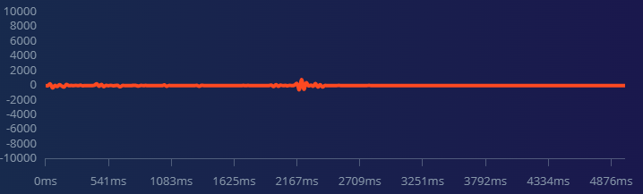
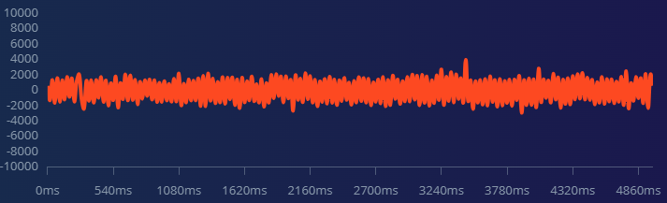
Dataset Exploratory
The data is classified into five categories based on rainfall intensity
VERY_HEAVY_RAIN
LOW_RAIN
VERY_HEAVY_RAIN
NO_RAIN
MODERATE_RAIN
Category of Rainfall (Classes) | Rainfall Intensity (mm)
VERY_HEAVY_RAIN | Greater than 3.5
HEAVY_RAIN | Between 1.5 - 3.5 exclusive
MODERATE_RAIN | Between 0.5 - 1.5 exclusive
LOW_RAIN | Between 0.08 - 0.5 exclusive
NO_RAIN | Below 0.08 - 0

Slide 11
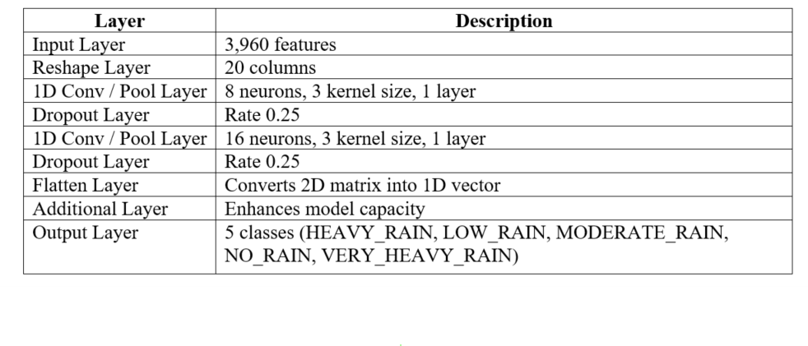
Model Selection
The neural network architecture for our rainfall classification model is based on a 1D Convolutional Neural Network (CNN)

Slide 12
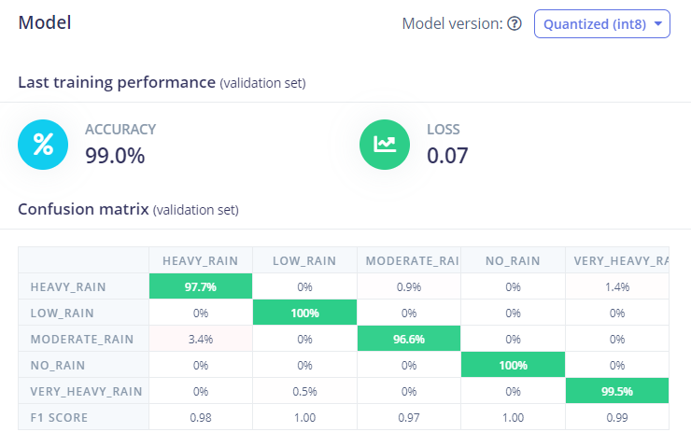
Model Training and Results
The training process involves optimizing the neural network parameters through backpropagation and gradient descent
The model is trained for 100 cycles with a learning rate of 0.005, using a CPU for computation

Slide 13
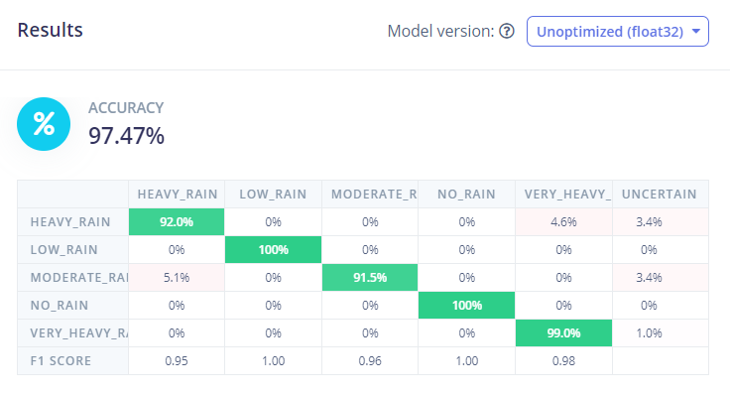
Model Testing Results
The performance of the trained model is evaluated on a validation set using metrics such as accuracy and loss. The model achieves an accuracy of 97.47% and a low loss value of 0.13.

Slide 14
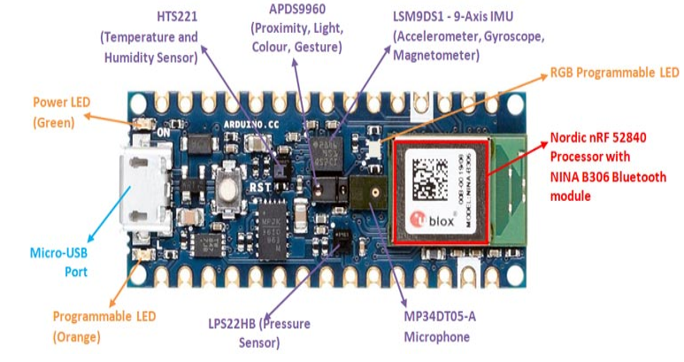
Model Deployment
Hardware board used in this development is Arduino Nano 33 BLE
Component | Specification
Microcontroller | nRF52840 (ARM Cortex-M4 CPU)
Operating Voltage | 3.3V
Input Voltage | 5V (via USB) or 4.5-21V (via VIN)
Digital I/O Pins | 14
Analog Input Pins | 8
Flash Memory | 1 MB
SRAM | 256 KB
Clock Speed | 64 MHz
Sensors | Microphone (MP34DT05) Barometric Pressure (LPS22HB) Temperature and Humidity (HTS221)

Slide 15
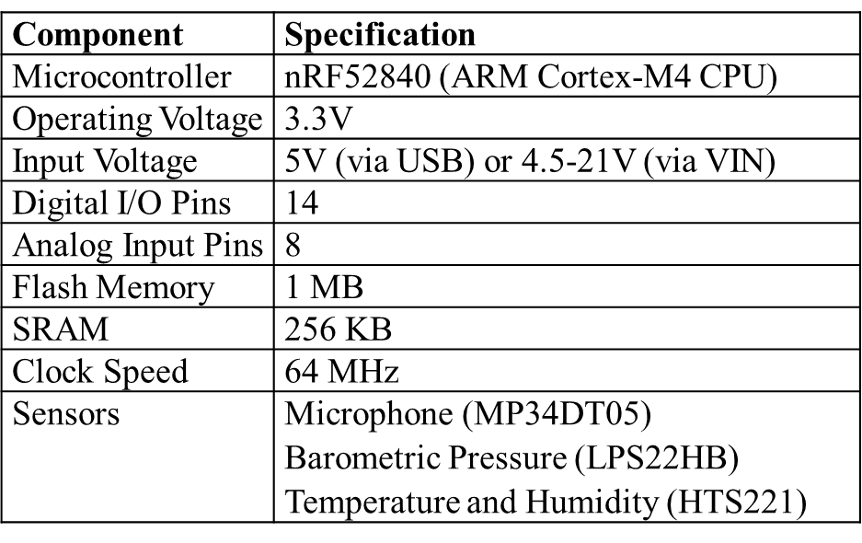
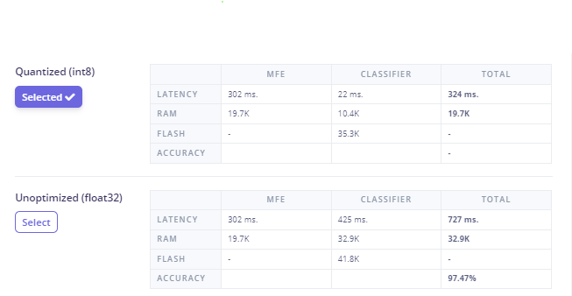
Model Deployment
Hardware board used in this development is Arduino Nano 33 BLE

Slide 16
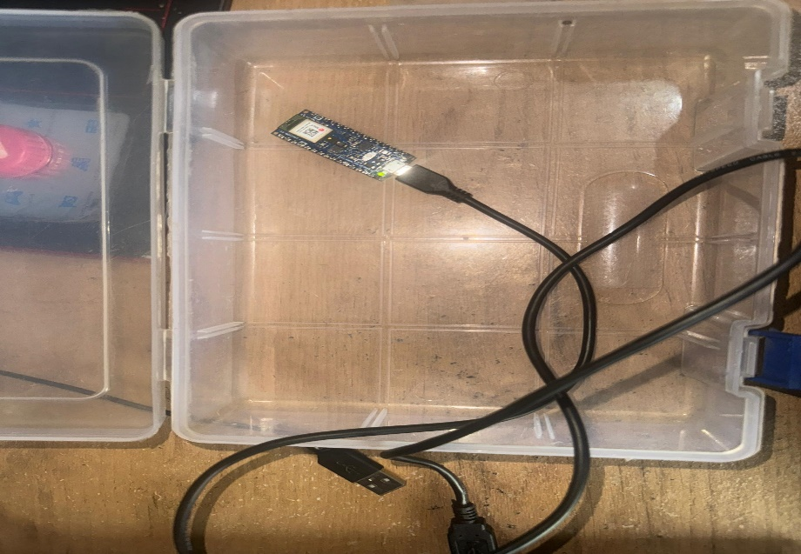
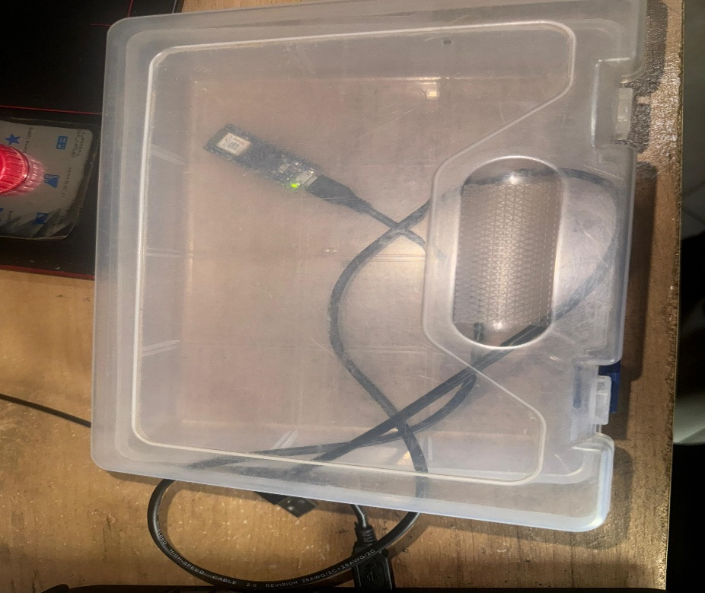
Model Deployment
The model was deployed as an Arduino library and loaded onto the Arduino Nano 33 BLE Sense for real-time inferencing
This deployment enables efficient, on-device rain monitoring, leveraging the board’s built-in sensors and processing capabilities
Prototype with cover opened
Prototype with cover closed

Slide 17
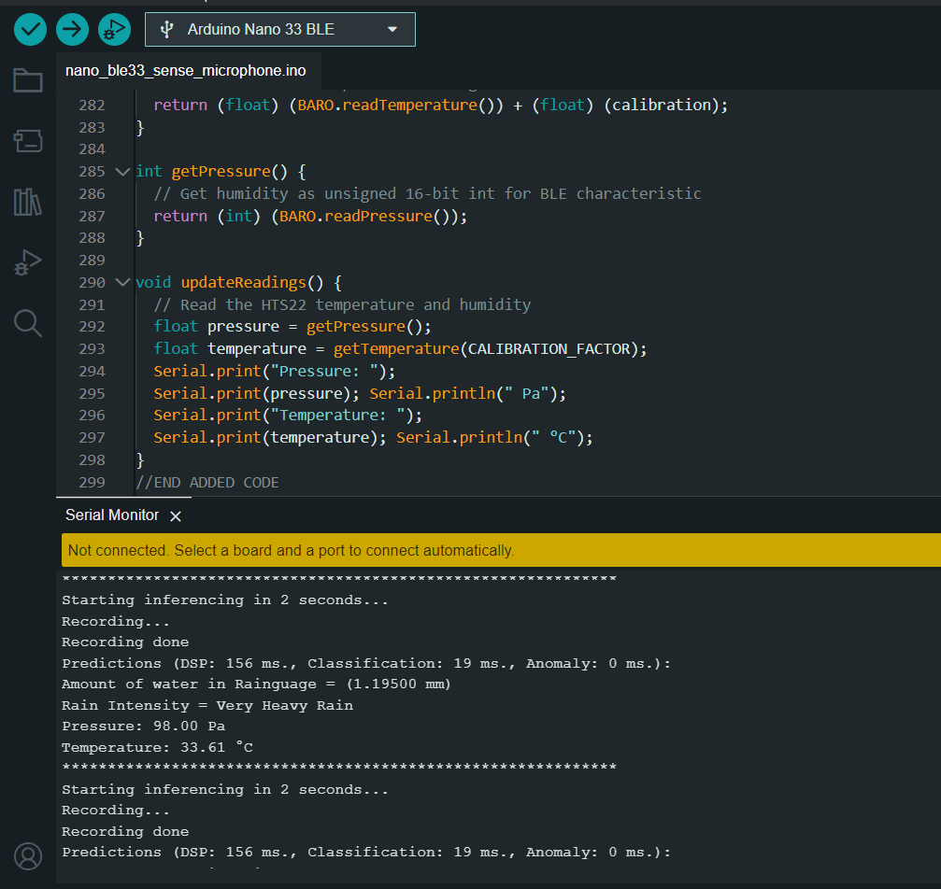
Model Deployment
Arduino IDE Interface with Serial Monitor Displaying Inferenced Result
The model was deployed as an Arduino library and loaded onto the Arduino Nano 33 BLE Sense for real-time inferencing
This deployment enables efficient real-time rainfall classification, temperature, and atmospheric pressure

Slide 18
DEMO

Slide 19
Future Work
Design and implement a smart weather station that displays readings on an LCD, web interface, or mobile application
Create a custom dataset for rain and wind parameters.
Modify existing dataset: Addition of noise class.
Field Tests Under Actual Rain
Connection of the Setup to an external battery source and measure power consumption

Slide 20

THANK YOU
20

